Slide 1
SciENcv, myBibliography, NIHMS & ORCID : an introduction
Julie Schneider
Ebling Library Director

Slide 2
Outline:
Review of NCBI Tools & Resources
Biosketch Changes
SciENcv : What It Is
SciENcv : Using It & What You Should Know
SciENcv : Creating a Biosketch
ORCID

Slide 3
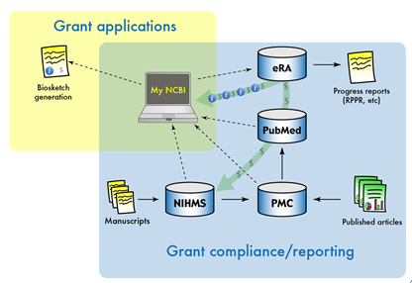
Integration of my NCBI Tools

Slide 4
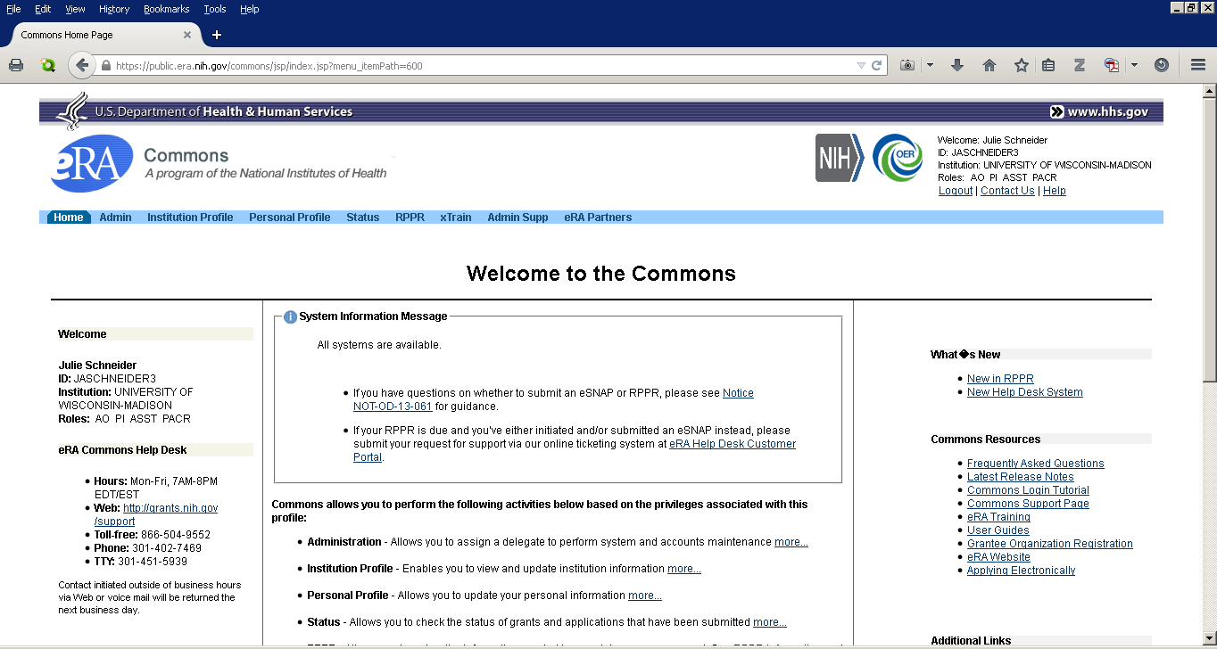
Notes:
Information from eRA Commons can populate portions of the SciENcv tool if you login to the tool using your eRA Commons login and password.
Information from my Bibliography citations will show up in the RPPR publications. The citations in RPPR from my Bibliography will show whether they are compliant or not with the NIH Public Access policy.

Slide 5
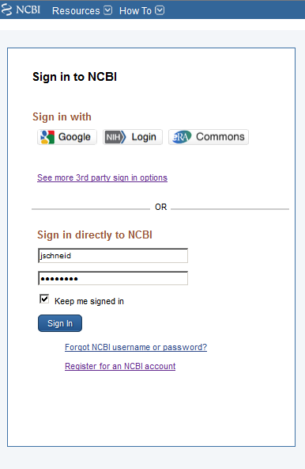
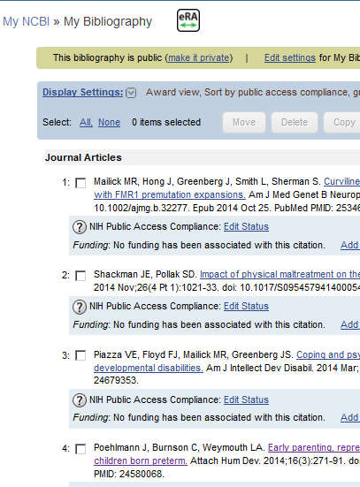

Slide 6

Integration of my NCBI Tools

Slide 7
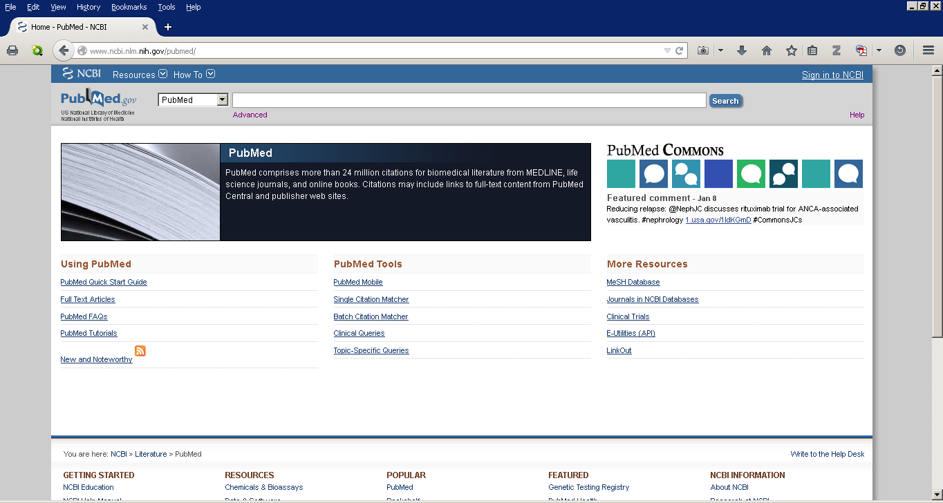
Notes:
PubMed is an index of the biomedical literature with nearly 25 million citations.

Slide 8
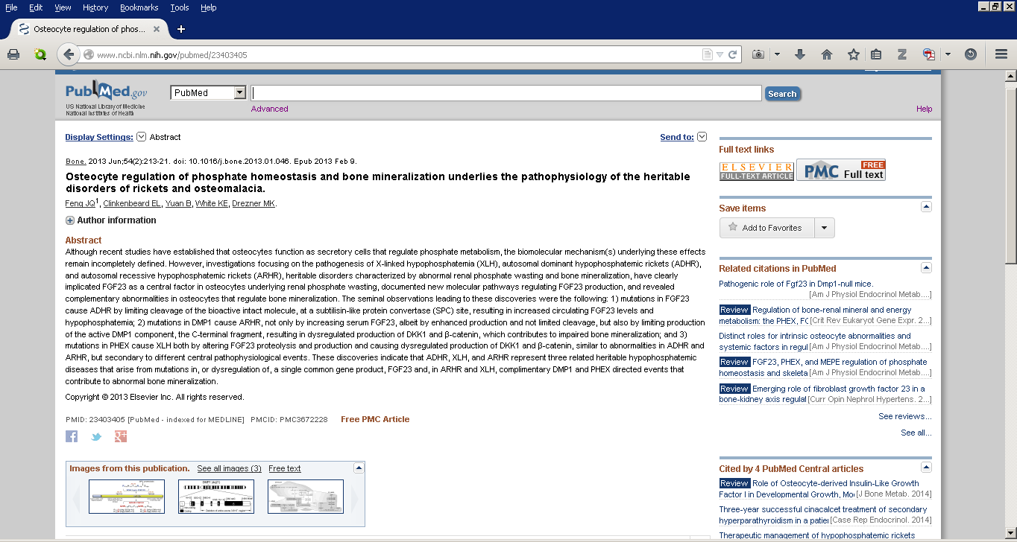
Notes:
Each individual citation record will include links to publisher and PubMed Central full text. You can find the PMCID (which is needed to show compliance with the NIH Public Access Policy) in the PubMed record. You can also upload a citation from PubMed into your myBibliography by clicking on the “Send To” arrow. The NIHMSID can not be found in PubMed.
The citation information from PubMed feeds into other myNCBI tools. Information from PubMed Central will feed back into PubMed.

Slide 9

Integration of my NCBI Tools

Slide 10
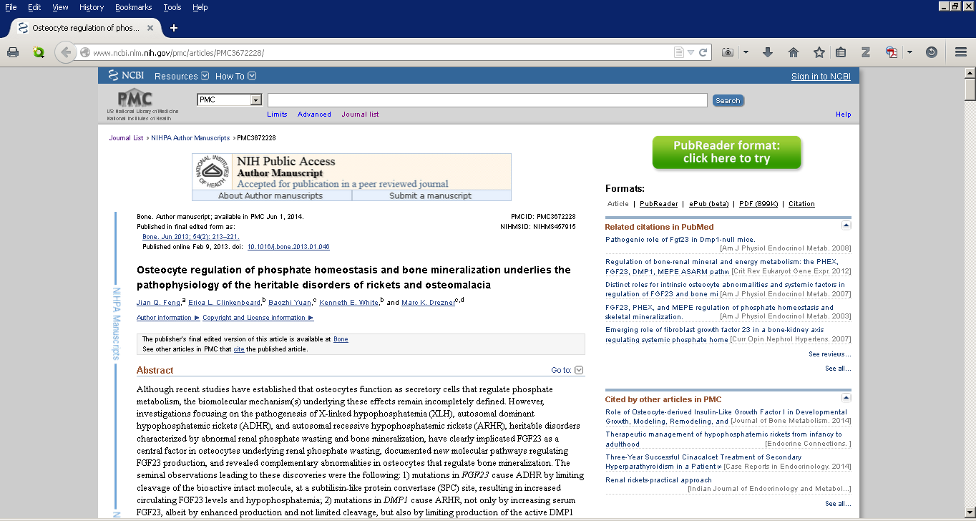
Notes:
The full text database is PubMed Central, PMC. The PMCID is indication of compliance with the policy. Three months post-publication, only the PMCID can show evidence of compliance. There are two methods that full-text articles get into PubMed Central; by publishers or others.

Slide 11
Integration of my NCBI Tools
Method C&D
Method A&B
Notes:
There are four methods that the full text of articles get into PubMed Central. Methods A & B are uploads of final published articles by publishers into PubMed Central. Methods C&D are submissions of final peer-reviewed manuscripts through the NIH Manuscript Submission System.

Slide 12
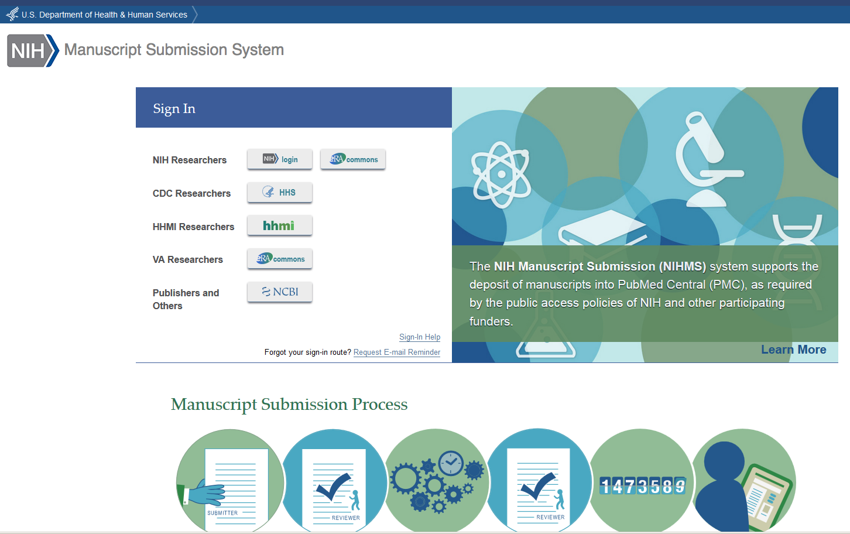
Notes:
This is current homepage of the NIH Manuscript Submission System. This system allows PIs, researchers and third parties (such as your friendly librarian) to submit final peer-reviewed manuscripts for final upload to PubMed Central. Everything submitted goes through two approvals steps that need to be done by one of the authors. The submitter assigns the author that will perform the two approval steps. Once both approval steps are completed, the manuscript is reformatted and the documents are uploaded into a PubMed Central queue, the PMCID is applied. This process must be completed and the PMCID applied by three months post-publication.

Slide 13
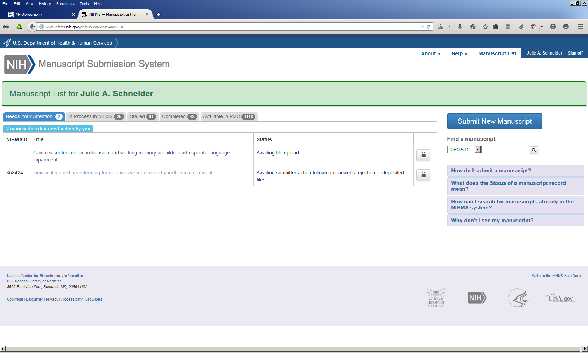

Slide 14
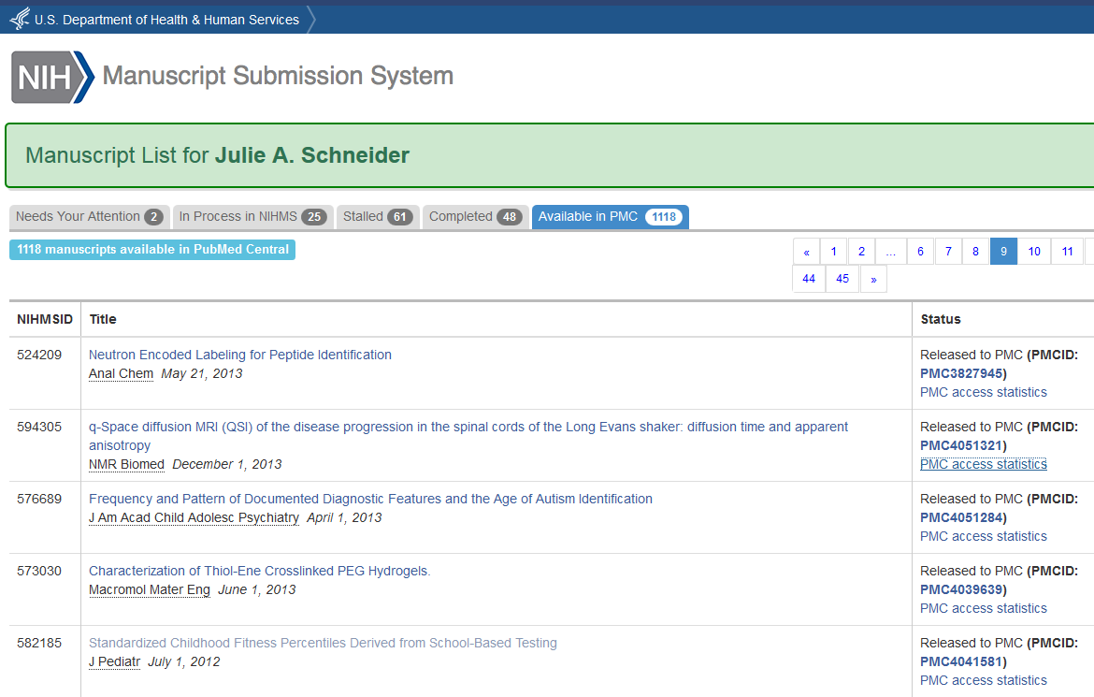
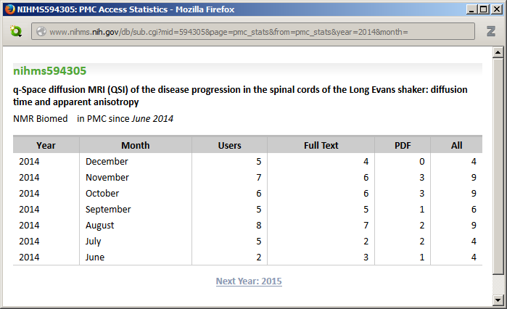

Slide 15
Integration of my NCBI Tools
Method C&D
Method A&B
Notes:
Information from the fields in PubMed, PubMed Central and the NIH Manuscript Submission System are all part of NCBI and transferred to other NCBI fields. The citation information and the public access IDs (NIHMSID & PMCID) can become part of the biosketch publications in SciENcv and become part of the RPPR in eRA Commons.

Slide 16
Outline:
Review of NCBI Tools & Resources
Biosketch Changes
SciENcv : What It Is
SciENcv : Using It & What You Should Know
SciENcv : Creating a Biosketch
ORCID

Slide 17
New Biosketch
NIH & AHRQ encourages applicants to use the new biosketch format for all grant applications submitted for due dates on or after January 25, 2015
NIH and AHRQ will require use of the new biosketch format in applications for research grants submitted for due dates on or after May 25, 2015. Between now and that time, applicants will have the choice of using the old or new biosketch format.
The new biosketch will:
  extend the page limit from four to five
  allow researchers to describe up to five most significant contributions to science along with the historical background that framed their research (Contributions to Science, Section C)
  allow you to include a link to works from a publicly available source

Slide 18
Biosketch Changes (details)
Contributions to Science
  Include a description of up to five of your most significant contributions to science
  The description of each contribution should be no longer than one half page including figures and citations
  Each description can be accompanied by a listing of up to four relevant peer-reviewed publications or other non-publication research products
URL to Works
  URL to a full list of your published works. Three options:
    PubMed: Create an Author query to link to works in PubMed (CAVEAT: does not always include all works by an author and if so, the query works only if the author name is unique)
    My Bibliography: Use the My Biblography "Sharing" feature to link to works
    SciENcv: Use the SciENcv "sharing" feature to link to works

Slide 19
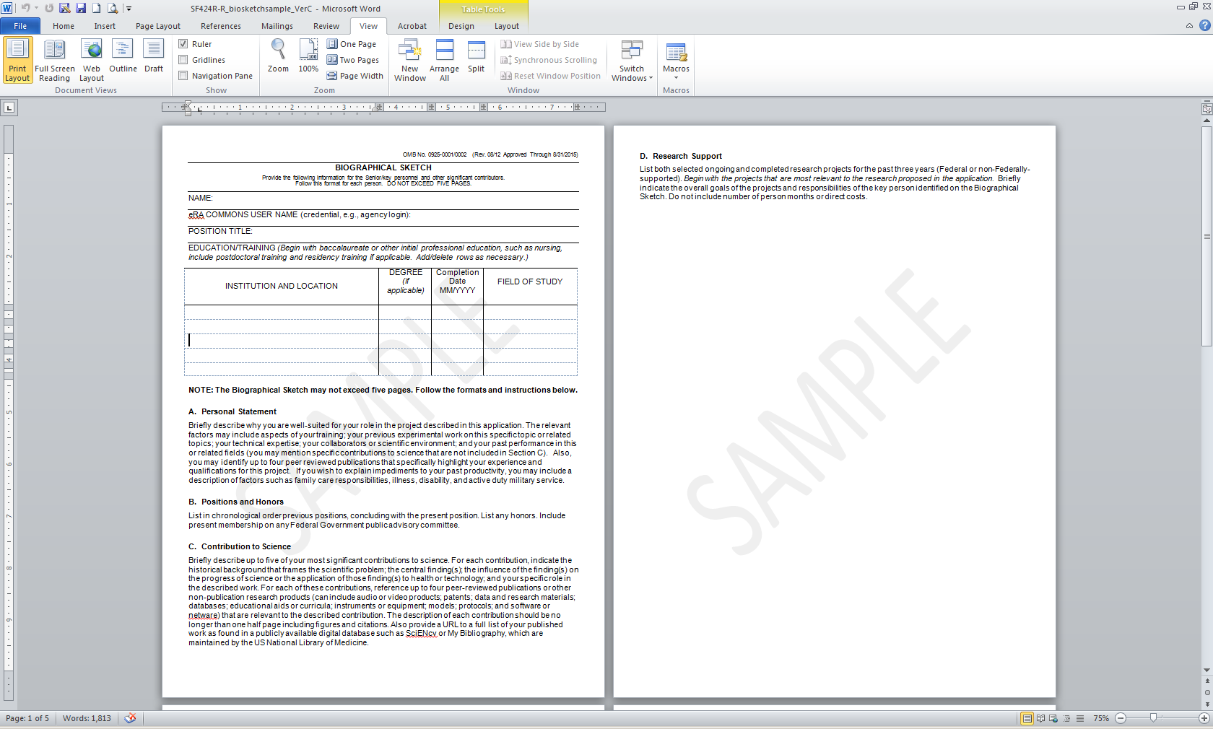
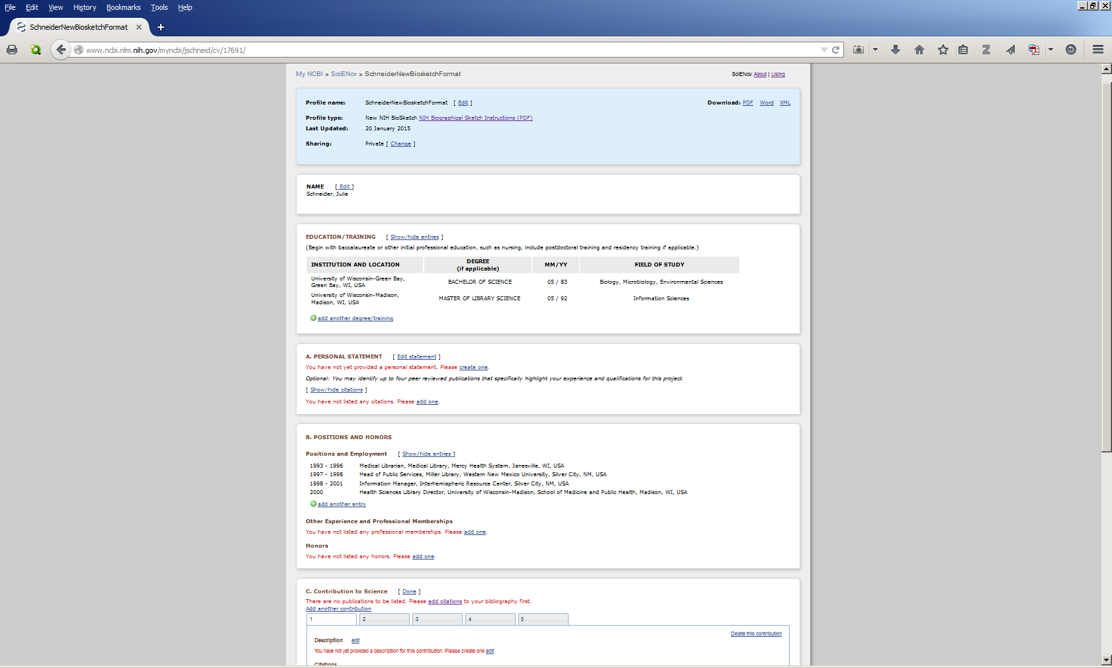

Slide 20
Outline:
Review of NCBI Tools & Resources
Biosketch Changes
SciENcv : What It Is
SciENcv : Using It & What You Should Know
SciENcv : Creating a Biosketch
ORCID

Slide 21
What is SciENcv
Science Experts Network Curriculum Vitae (SciENcv) is an electronic system that will enable researchers to easily assemble biographical information in order to simplify the work flow associated with federal funding.

Slide 22
Outline:
Review of NCBI Tools & Resources
Biosketch Changes
SciENcv : What It Is
SciENcv : Using It & What You Should Know
SciENcv : Creating a Biosketch
ORCID

Slide 23
Why Might You Want to Use SciENcv?
Eliminates the need to repeatedly enter some biosketch information
Reduces the administrative burden associated with federal grant submission and reporting requirements
Provides access to a researcher-claimed data repository with information on expertise, employment, education, and professional accomplishments
Allow researchers to describe their scientific contributions in their own language

Slide 24
Things You Need to Know about SciENcv
Resulted from an Interagency Collaboration of NIH, DOD, DOE, EPA, NSF, USDA and the Smithsonian
Currently supports NIH & AHRQ biosketches (NSF biosketches is in beta)
SciENcv is not required for generating a new biosketch
SciENcv was released in beta in September 2013
SciENcv 2.0 was formally released in May 2014
SciENcv was reformatted in mid-January 2015
Link to published works is not required
Links and can extract information from eRA Commons, other NIH data resources and ORCID
Updates to the tool are being made regularly

Slide 25
Outline:
Review of NCBI Tools & Resources
Biosketch Changes
SciENcv : What It Is
SciENcv : Using It & What You Should Know
SciENcv : Creating a Biosketch
ORCID

Slide 26
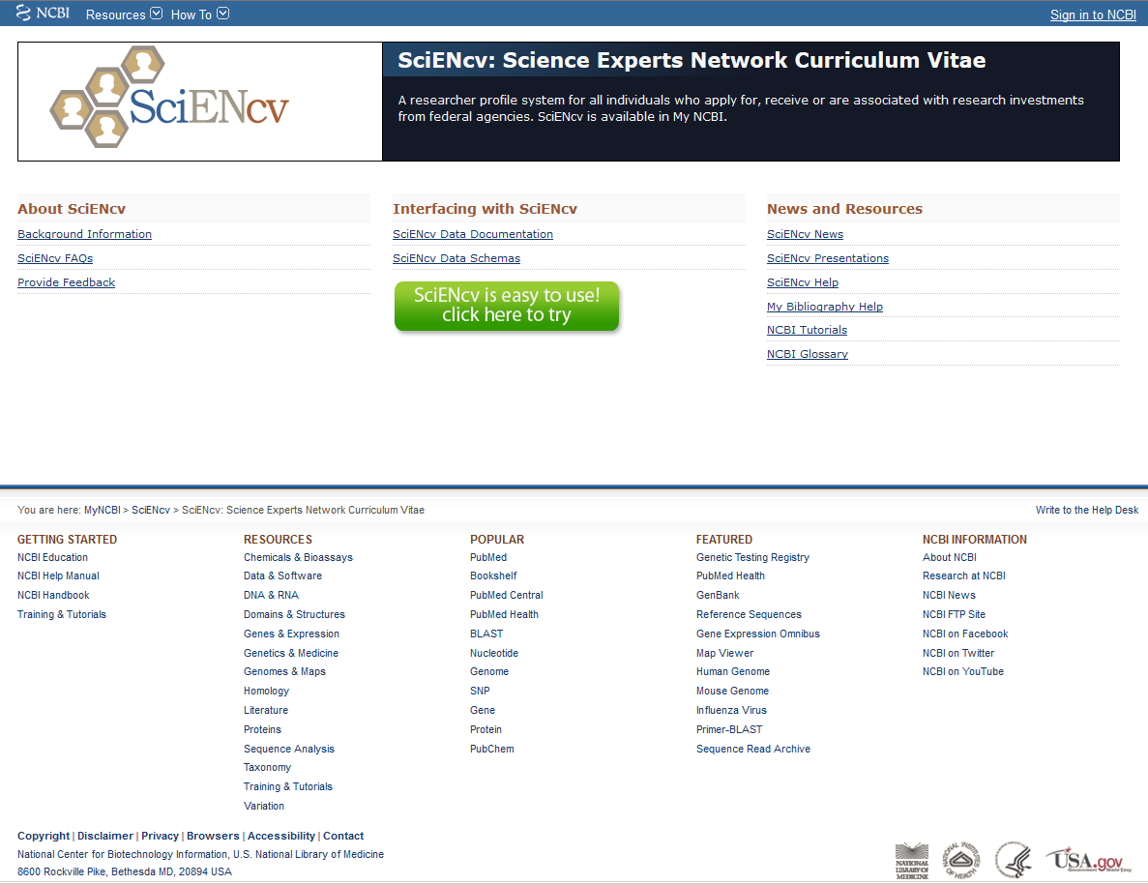
SciENcv : Science Experts Network Curriculum Vitae http://www.ncbi.nlm.nih.gov/sciencv/

Slide 27
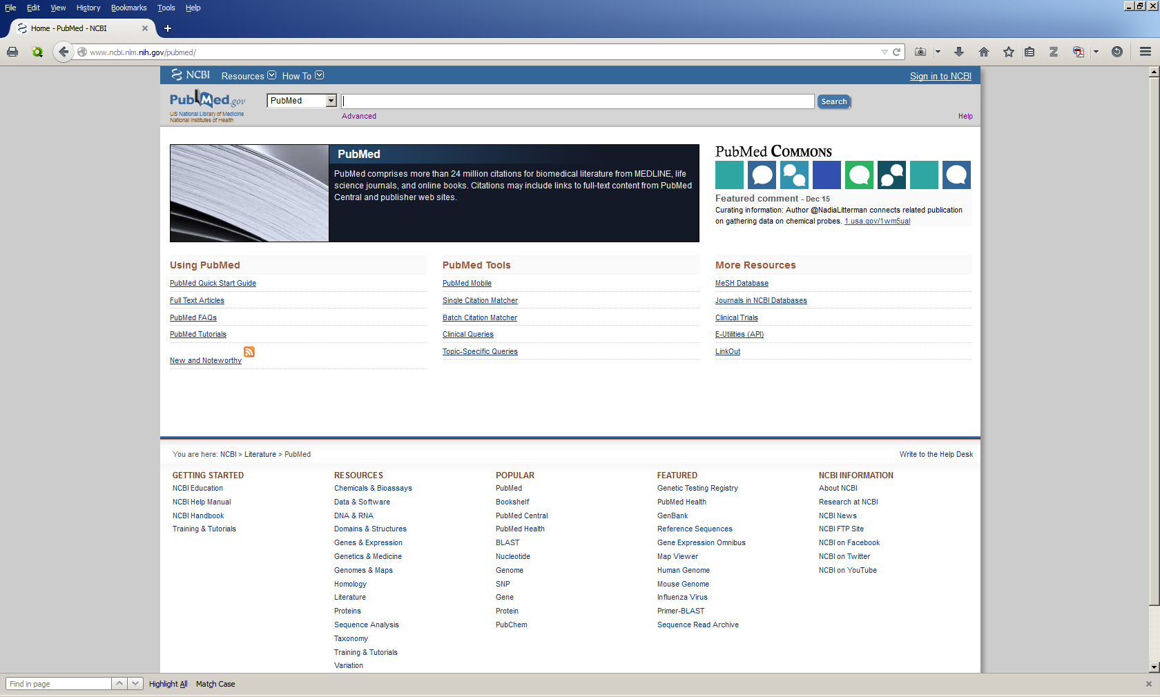

Slide 28
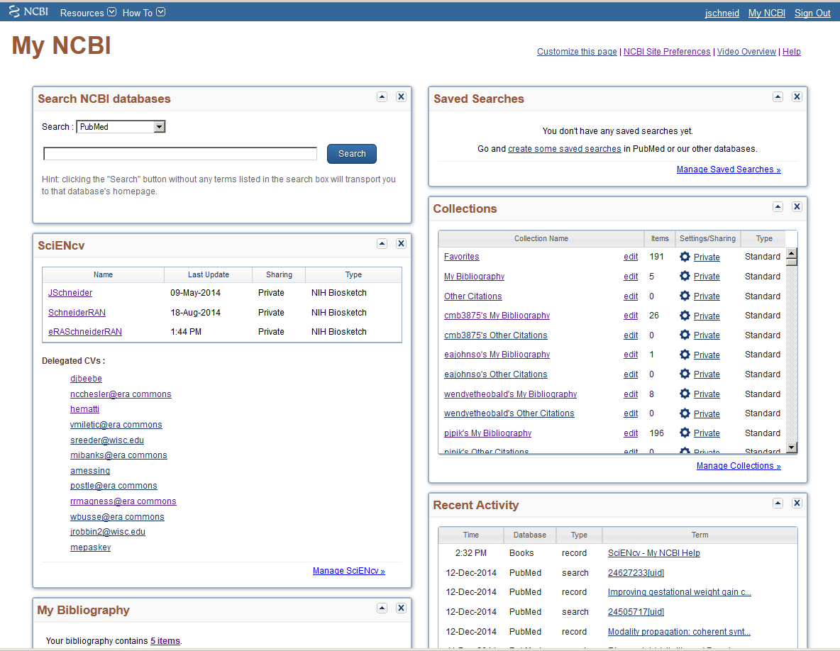

Slide 29
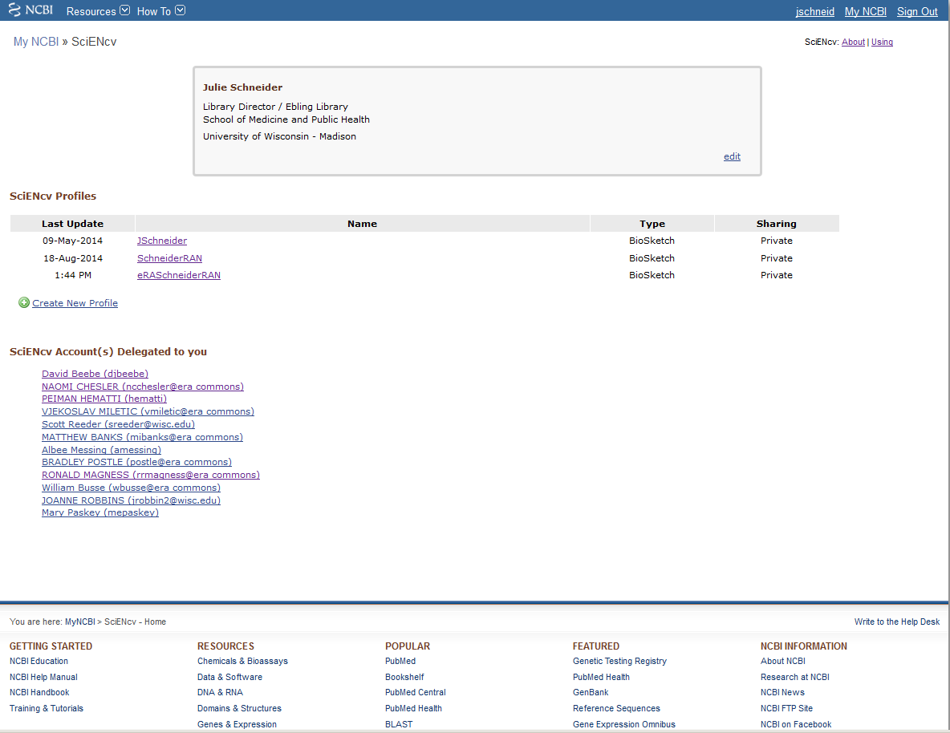



Slide 30
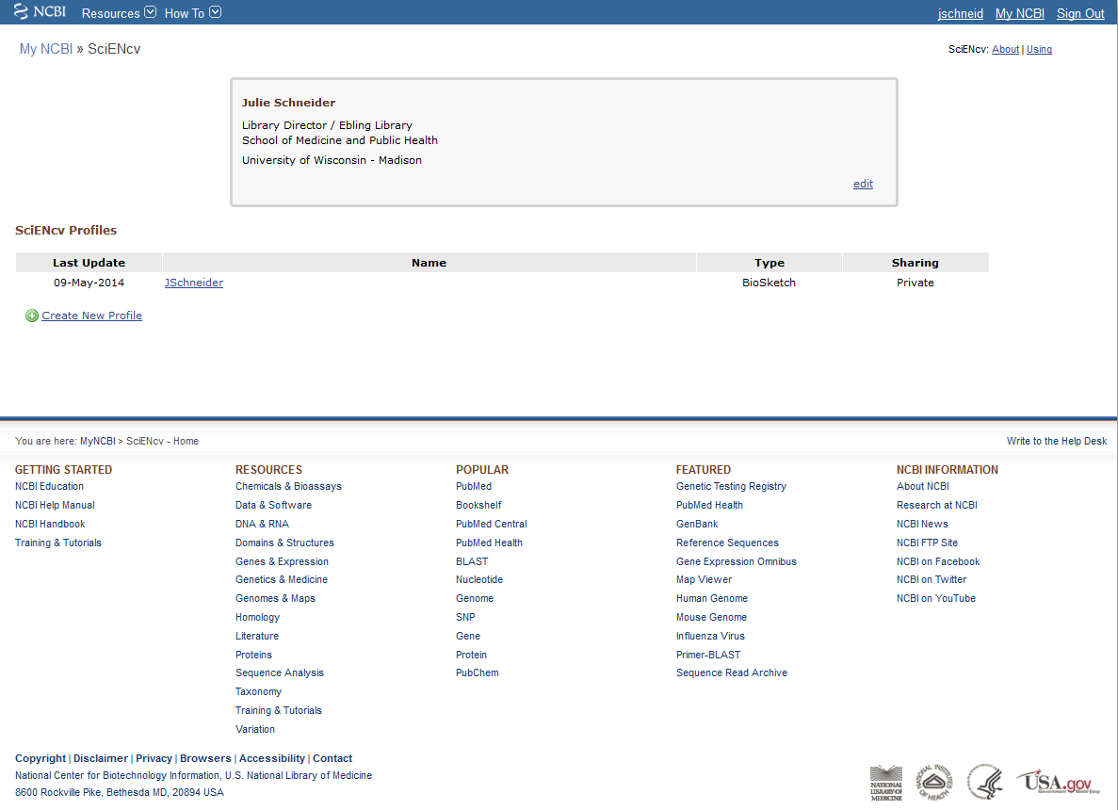

Slide 31
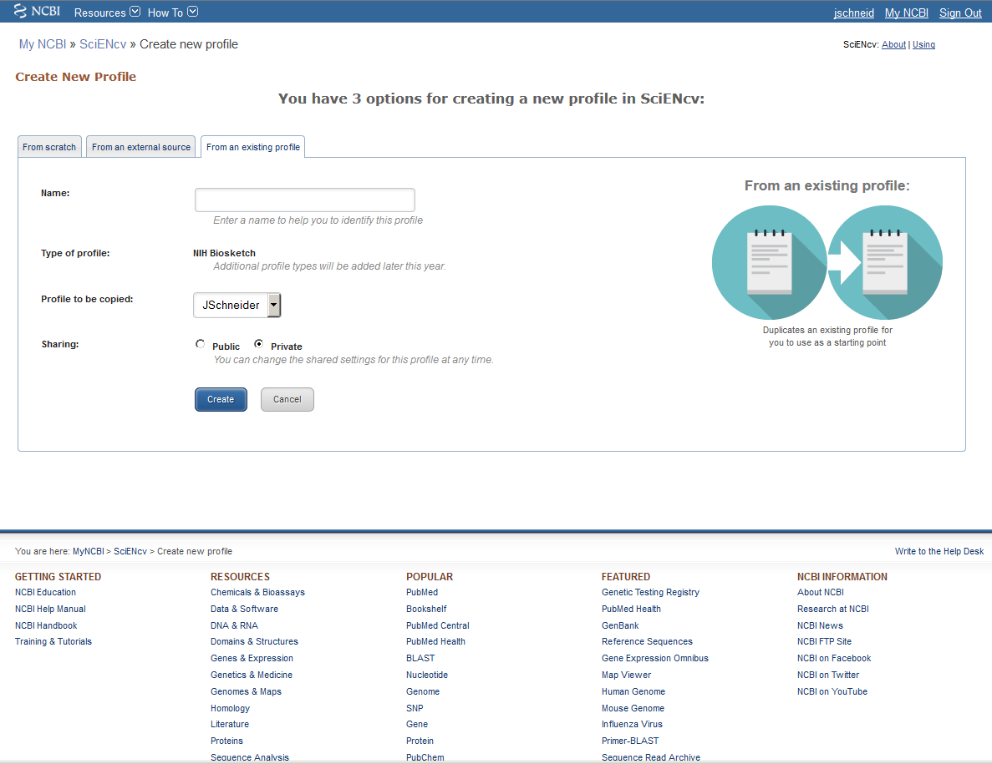


Slide 32
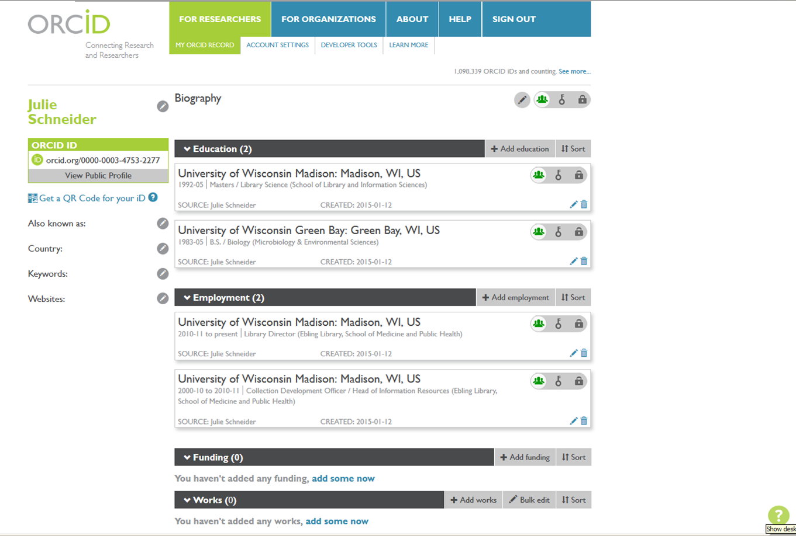
ORCID ID (orcid.org)

Slide 33
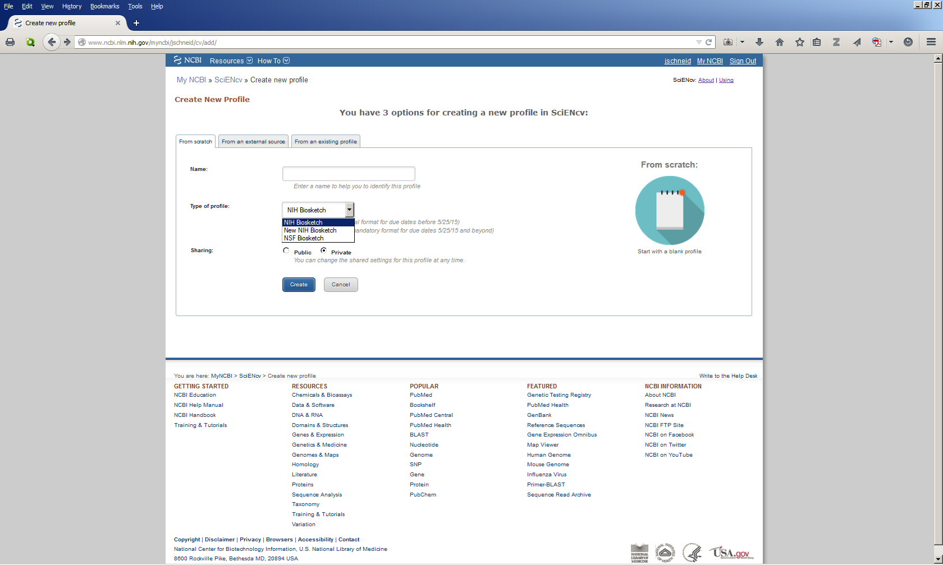

Slide 34
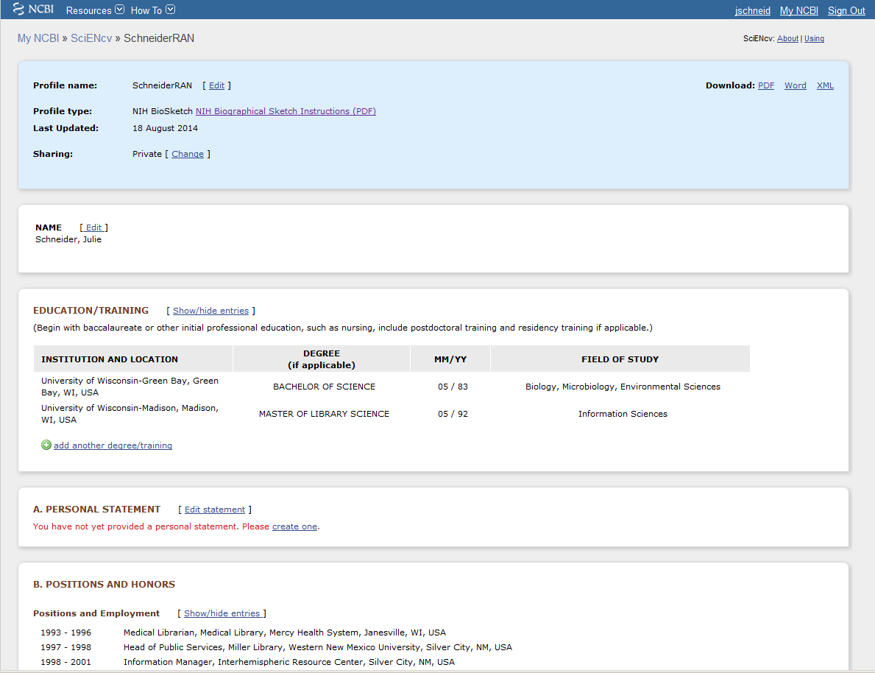


Slide 35
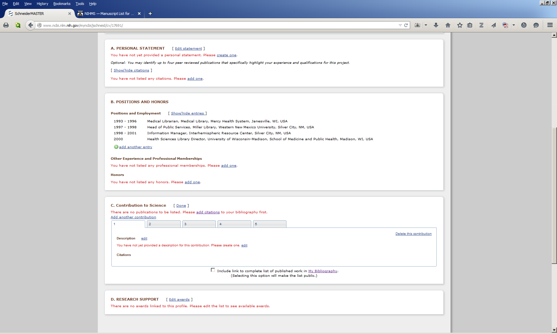



Slide 36
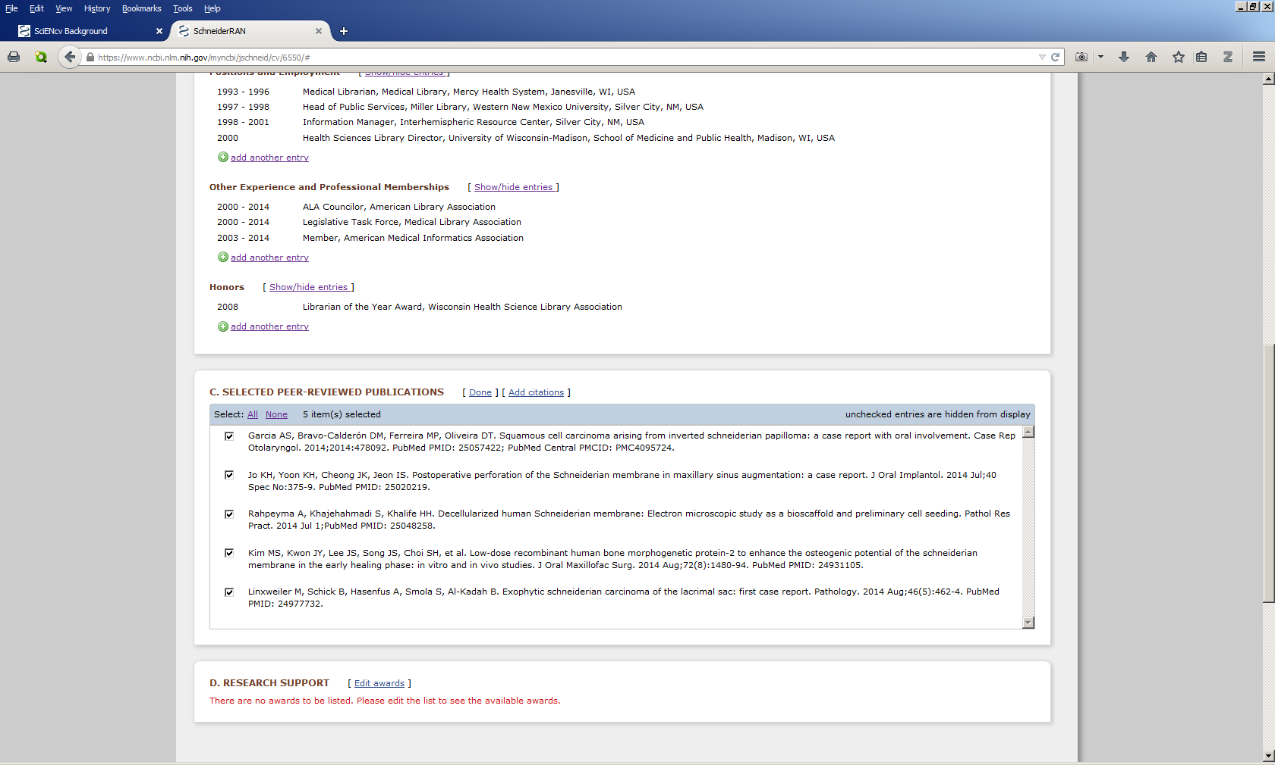

Slide 37
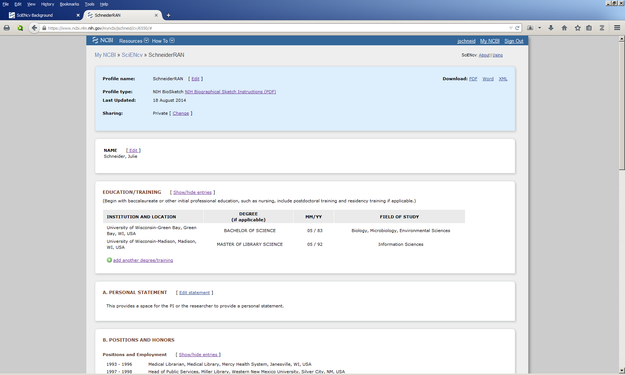

Slide 38
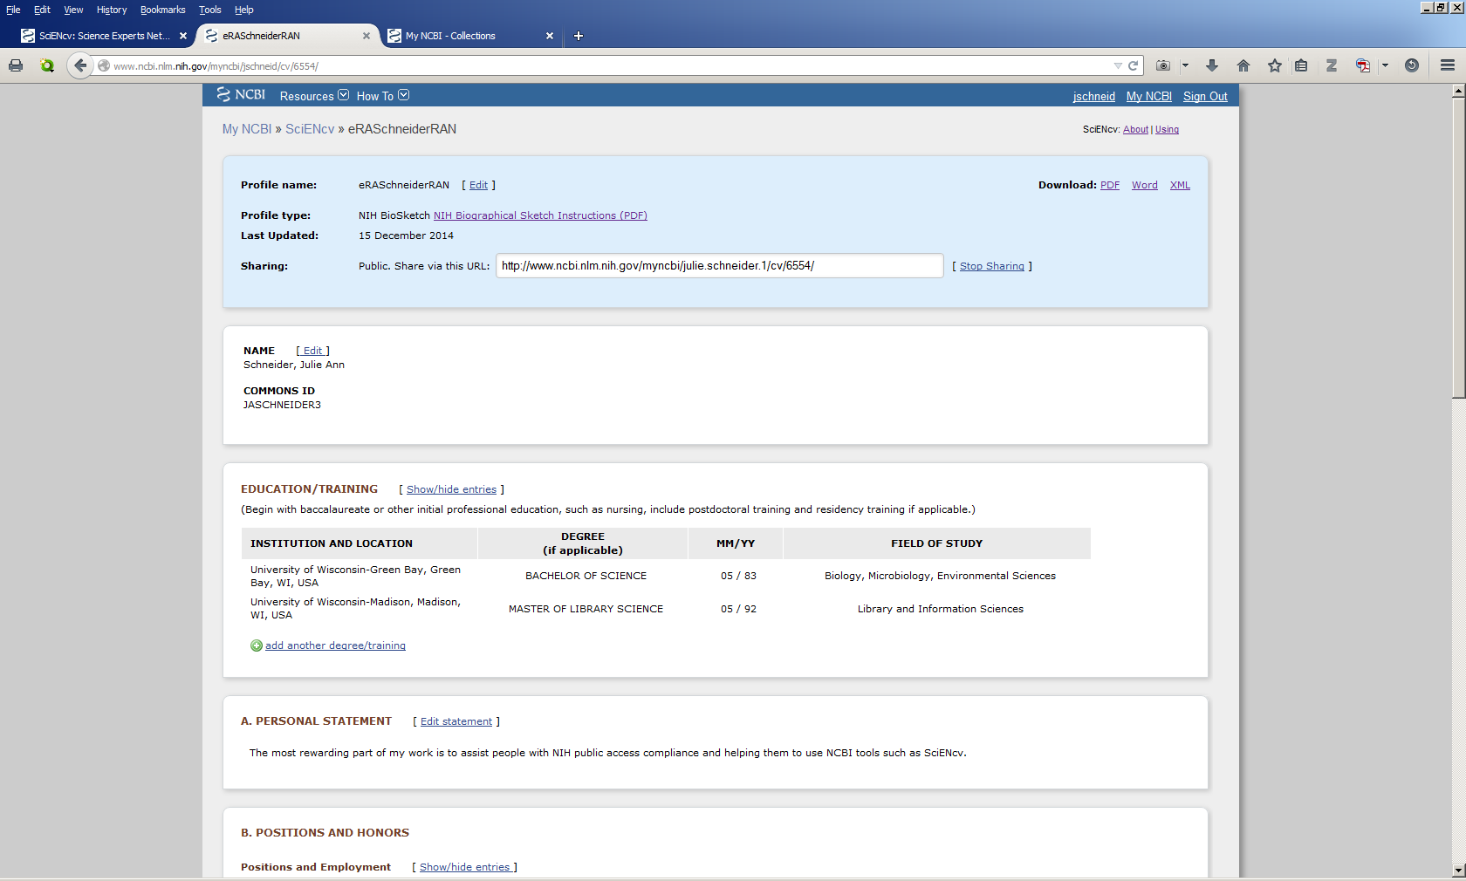


Slide 39
Outline:
Review of NCBI Tools & Resources
Biosketch Changes
SciENcv : What It Is
SciENcv : Using It & What You Should Know
SciENcv : Creating a Biosketch
ORCID

Slide 40
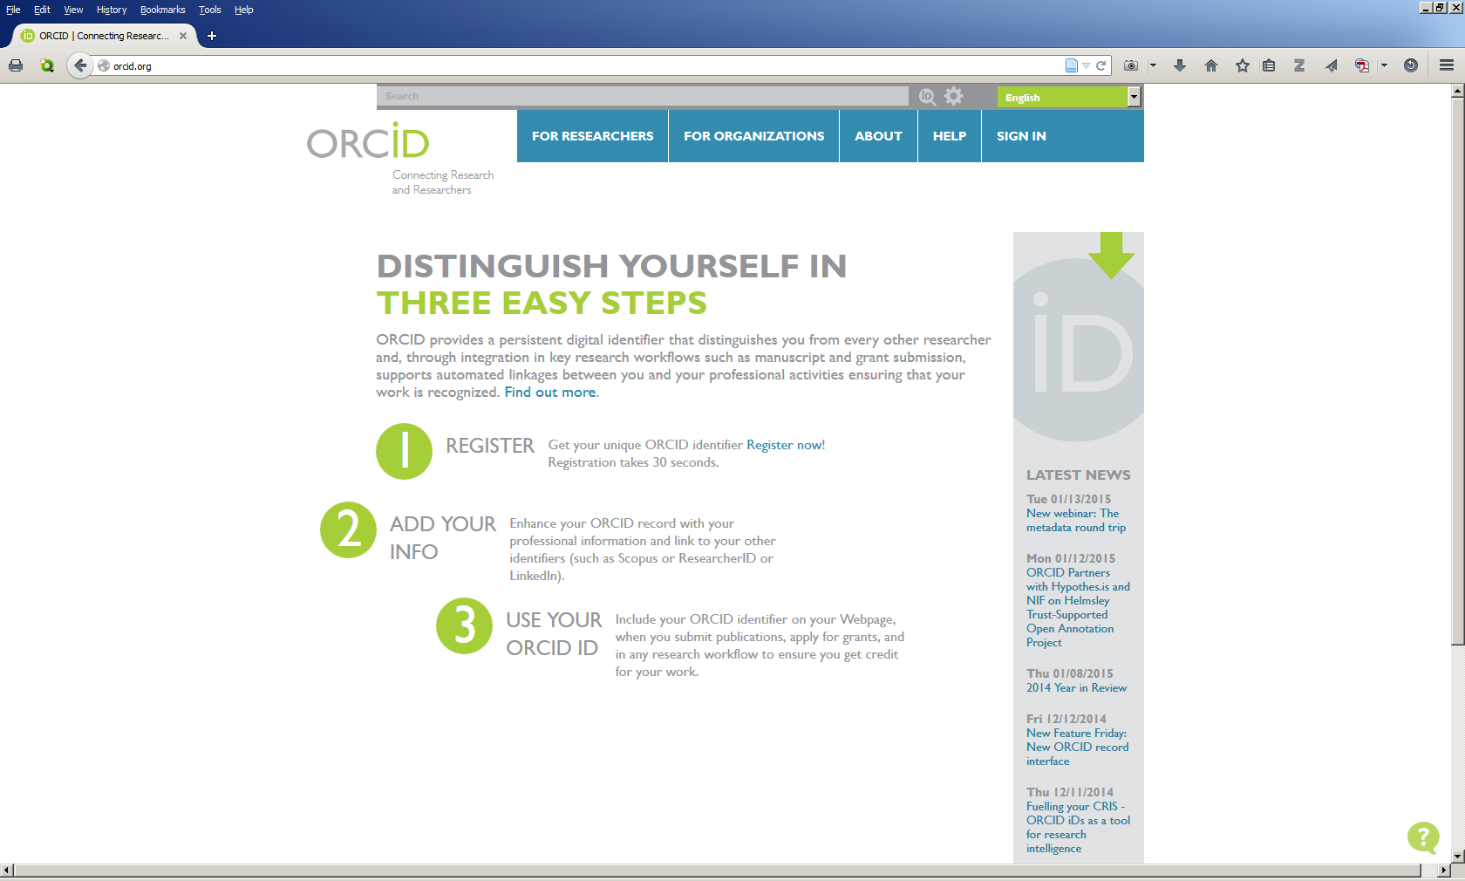

Slide 41
Questions?
NIH Public Access? SciENcv? my Bibliography? NIH Manuscript Submission System? ORCID?
Julie Schneider, Ebling Library Director
jschneider@library.wisc.edu
608-263-5755
People Who Can Help:
Trisha Adamus, adamus@wisc.edu
Rhonda Sager, rsager@library.wisc.edu
Mary Hitchcock, mhitchcock@library.wisc.edu

